Slide 1


ALUR PROSES ONBOARDING
YOE - YokkeBiz
Copyright © 2021 PT Mitra Transaksi Indonesia. All rights reserved. This document/proposal or any portion is confidential, thereof may not be reproduced or used in any manner whatsoever without the express written permission of PT Mitra Transaksi Indonesia.

Slide 2







Kondisi Existing Mekanisme Alur Onboarding Merchant
Bisnis Deal Merchant
Team MY Digital
Create Dashboard YokkeBiz
Input merchant ke dalam aplikasi ASANA
Created Report Manual
Bisnis Deal Merchant
Team Digital Business

Slide 3
Kondisi Existing Mekanisme Alur Onboarding - UMKM
ADO | Bisnis | YokkeBiz Ops
Start
Start
Demo Aplikasi YokkeBiz
Demo Aplikasi YokkeBiz mellaui Event
Submit data by WAG
Submit data by WAG (File Excel)
Created Dashboard Dummy
Collect Dokumen
Konfirmasi ke WAG
Eksepsi
No
Input Dokumen ke ASANA
Yes
Store Set Up
Go Live

Slide 4
Kondisi Existing Mekanisme Alur Onboarding - Reguler
ADO | Bisnis | YokkeBiz Ops | iSeller
Start
Start
Demo Aplikasi YokkeBiz
Demo Aplikasi YokkeBiz
Tim YokkeBiz input Data Merchant
ke ASANA
Submit data by WAG
Submit data by WAG
Registrasi Trial di ASANA
Tertarik
Trial
Tidak tertarik
Pending Merchant
Unpaid Register
Collect Dokumen
Konfirmasi ke WAG
Registrasi di ASANA
Konfirmasi merchant untuk pembayaran & TTD CL
Kirim bukti bayar & CL ke WAG
Input bukti bayar & CL ke ASANA
Store Set Up
A

Slide 5
Kondisi Existing Mekanisme Alur Onboarding - Reguler
ADO | Bisnis | YokkeBiz Ops | iSeller
A
Training Confirmation ke Merchant
Training & Setting Device
Konfirmasi Jadwal Live
Merchant Konfirmasi
Pending sisi Merchant
Merchant Restoration
ADO konfirmasi di WAG untuk Tanggal Live
Mengisi Google Form & Google Spreadsheet
Mengisi Dokumen Live Plan
Live Plan iSeller
Go Live
Semua aktifitas dari konfirmasi & Request melalui WAG (Tim Bisnis, ADO, dan YokkeBiz Ops) & Komunikasi personal ke tim YokkeBiz Ops
Pencatatan aktifitas melalui aplikasi ASANA
Belum ada batasan maupun approval untuk request Trial & Training
Masing-masing tim maupun group tidak dapat update terkait status onboarding merchant

Slide 6
Kondisi Existing Mekanisme Alur Status Maintenance – Merchant Update
ADO | Bisnis | YokkeBiz Ops | iSeller
Merchant Request Ke Tim ADO
Merchant Request Ke Tim Bisnis
Merchant Request Ke Tim YokkeBiz Ops
Request Maintenance
Collect Dokumen
Proses Maintenance
Konfirmasi ke Team iSeller
Merchant Re-Activation
Extend Trial Priod
Merchant Withdrawal
Renewal Subscription
Merchant Info Change
YokkeBiz Info Change
Menu Info Change
Done

Slide 7
Kondisi Existing Mekanisme Alur Status Maintenance – Service Request
ADO | Bisnis | YokkeBiz Ops
Merchant Request Ke Tim ADO
Merchant Request Ke Tim Bisnis
Merchant Request Ke Tim YokkeBiz Ops
Proses Maintenance
Done
Semua aktifitas dari konfirmasi & Request melalui WAG (Tim Bisnis, ADO, dan YokkeBiz Ops) & Komunikasi personal ke tim YokkeBiz Ops
Segala aktifitas Maintenance – Merchant Update tidak tercatat
Masing-masing tim maupun group tidak dapat update terkait status Maintenance maupun service request merchant

Slide 8
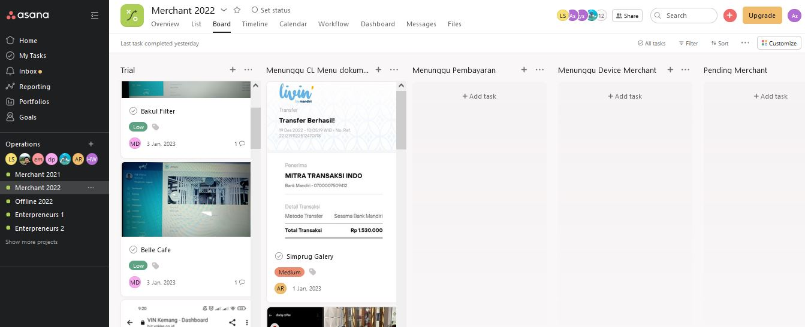
Kondisi Existing Pencatatan Merchant Dengan ASANA
Existing semua pencatatan Alur Onboarding merchant menggunakan ASANA
Keterbatasan :
- Maks 15 user - Keterbatasan Field
- Tidak adaya Dashboard Monitoring

Slide 9
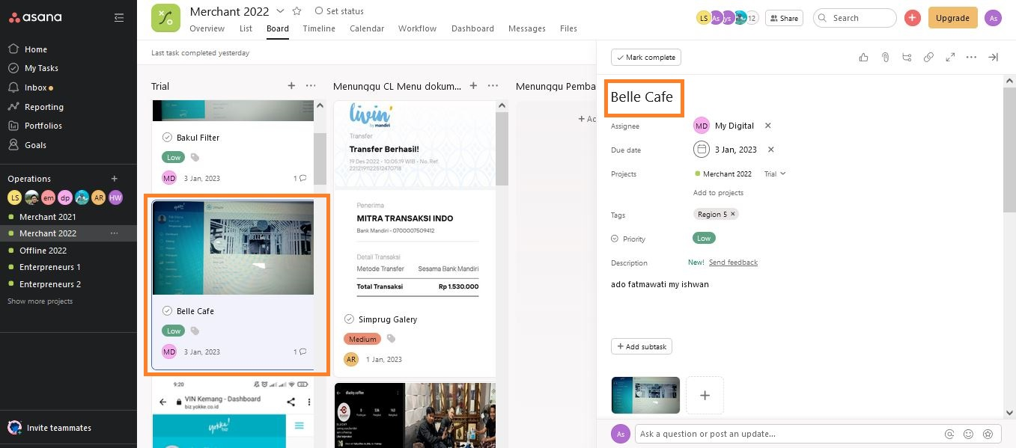
Kondisi Existing Pencatatan Merchant Dengan ASANA
Berikut adalah contoh create merchant pada ASANA pada state Trial.
Keterbatasan Field pada ASANA yang membuat tidak semua informasi dapat di input ke dalam ASANA

Slide 10
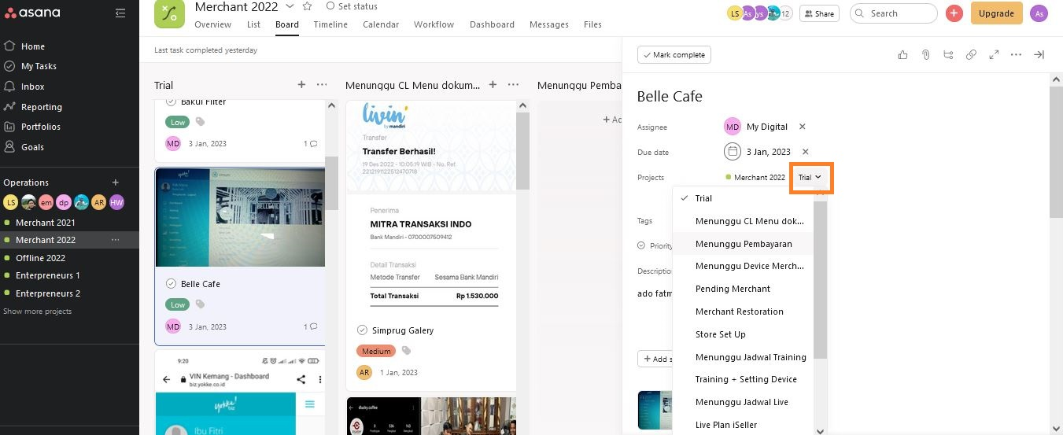
Kondisi Existing Pencatatan Merchant Dengan ASANA
Berikut adalah contoh update status merchant pada ASANA. Karena keterbatasan user maka untuk update status merchant hanya dapat dilakukan oleh 15 user tersebut yg dimana pada setiap status tidak dapat di Assigne kepada salah satu group yg terkait.

Slide 11

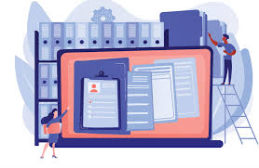
Kondisi Mekanisme Alur Onboarding Merchant Pada YOE
Bisnis Deal Merchant
Team MY Digital
Document Register
Proses onboarding merchant oleh team Digital Business dan team Technical YokkeBiz sampai dengan Go Live
Bisnis Deal Merchant
Team Digital Business

Slide 12
Mekanisme Alur Onboarding (Trial)
12
SR-ADO | ADO-Admin | YokkeBiz-Admin | YokkeBiz-Approval | YokkeBiz-Ops | iSeller
Start
Start
Start
Ticket dari SR Akuisisi
Create Ticket
State: Draft
Create Ticket
State: Draft
Merchant Test
State: Merchant Test
Submit
Submit
Hasil Submit Data
State: Submit Request
Submit
Return
Permintaan Dokumen
State: Collect Document
Collect Document
Dokumen
Lengkap
Submit
Cek & Registrasi Data
State: Data Entry
Dokumen
Lengkap
Reject
State: Trial
Sub State: Re-Approach
Submit
*14 days trial
State: Trial
Sub State: Go Live Documents
B
A

Slide 13
Mekanisme Alur Onboarding (Trial)
13
SR-ADO | ADO-Admin | YokkeBiz-Admin | YokkeBiz-Approval | YokkeBiz-Ops | iSeller
B
Return
A
Lanjut
Proses
Submit
State: Trial
Sub State: Store Setup
Dokumen
Lengkap
Pending
Eksepsi
Approval Bisnis
State: Approval Request
State: Trial
Sub State: Pending Merchant
Return
Approve
Approve
State: Trial
Sub State: Re-Approach
Reject
Submit
C

Slide 14
Mekanisme Alur Onboarding (Trial)
14
SR-ADO | ADO-Admin | YokkeBiz-Admin | YokkeBiz-Approval | YokkeBiz-Ops | iSeller
C
State: Trial
Sub State: Training Confirmation
Return
State: Trial
Sub State: Pending Merchant
State: Trial
Sub State:Training-Setting Device
Proses
Lanjut
Proses
Lanjut
Pending
Submit
Submit
State: Go Live Preparation
Sub State: Go Live Confirmation
Return
State: Go Live Preparation
Sub State: Merchant Restoration
Proses
Lanjut
State: Live Merchant
Sub State:Live Plan iSeller
Proses
Lanjut
Pending
Submit
Submit
State: Live Merchant
Sub State: Live Merchant

Slide 15
Mekanisme Alur Onboarding (Non Trial)
15
SR-ADO | ADO-Admin | YokkeBiz-Admin | YokkeBiz-Approval | YokkeBiz-Ops | iSeller
Start
Start
Start
Create Ticket
State: Draft
Create Ticket
State: Draft
Create Ticket
State: Draft
Merchant Test
Submit
State: Merchant Test
Submit
Submit
Hasil Submit Data
State: Submit Request
Submit
Yes
Approval Request
State: Approval Request
Return
Permintaan Dokumen
State: Collect Document
Collect Document
Proses
Lanjut
Submit
State: Trial
Sub State: Re-Approach
Reject
Eksepsi
Approval
Approve
Cek & Registrasi Data
State: Data Entry
Proses
Lanjut
No
State: Go Live Preparation
Sub State: Merchant Restoration
Reject
State: Go Live Preparation
Sub State: Store Setup
Submit
State: Live Merchant
Sub State: Live Merchant

Slide 16
ALUR PROSES ONBOARDING AKUISISI MERCHANT YOKKEBIZ
SR -ADO

Slide 17
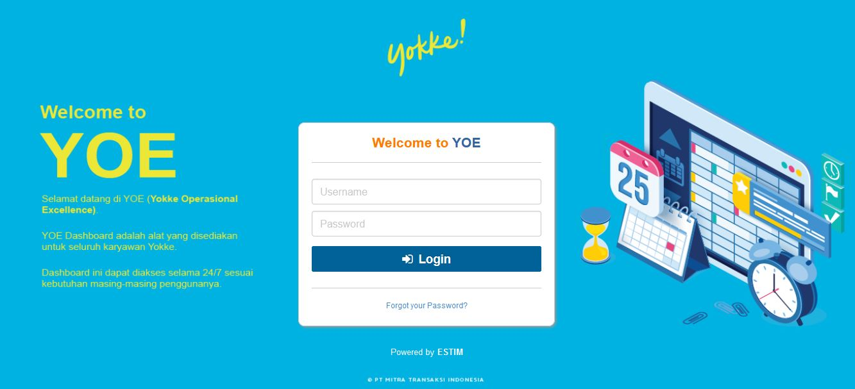
Tampilan Login YOE – Portal Onboarding YokkeBiz
Keterangan:
Input Username dan Password untuk Login ke Dalam Portal YokkeBiz

Slide 18
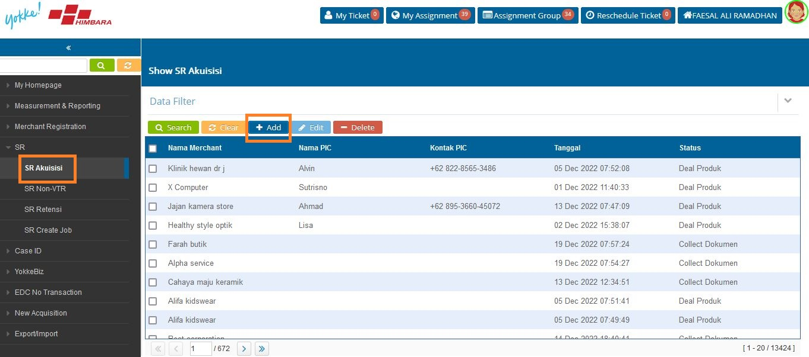
Tampilan User SR - ADO
Masuk ke Menu SR
Pilih SR Akuisisi
Klik Add

Slide 19
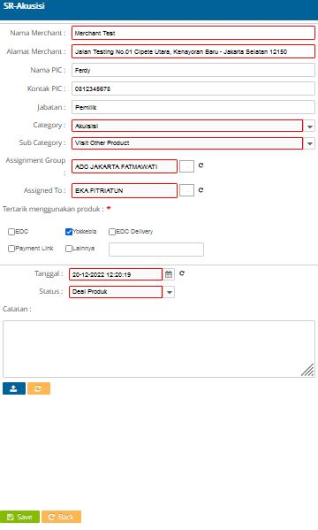
Isi NamaMercant
Isi Alamat Merchant
Isi Nama PIC, Kontak PIC, dan Jabatan PIC Merchant
Category di isi Akuisisi
Sub Category di isi Visit Other Product
Assignment Group di isi area ADO Akuisisi Merchant
Assignment To di isi salah satu user pada area ADO tersebut
Ceklis YokkeBiz bila hanya YokkeBiz saja. Namun bila Akuisisi lebih dari satu produk maka di ceklis sesuai produk yg di Akuisisi. Contoh ceklis EDC dan YokkeBiz
Tanggal di isi Tanggal dan Waktu Akuisisi
Status di isi Deal Product
Klik Tombol Biru dibawah kolom catatan bila ada dokumen yg akan di upload
Klik Save

Slide 20
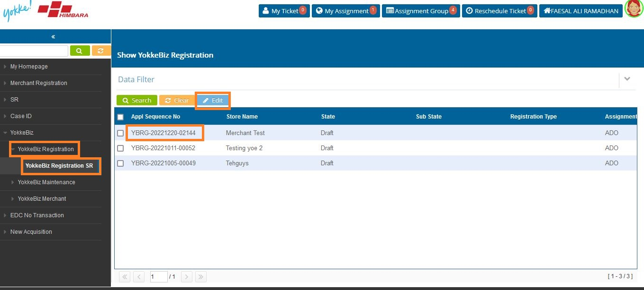
Onboarding Merchant YokkeBiz
Masuk ke Menu YokkeBiz
Pilih YokkeBiz Registration
Pilih YokkeBiz Registration SR
Klik Nomor Tiket
Klik Edit

Slide 21
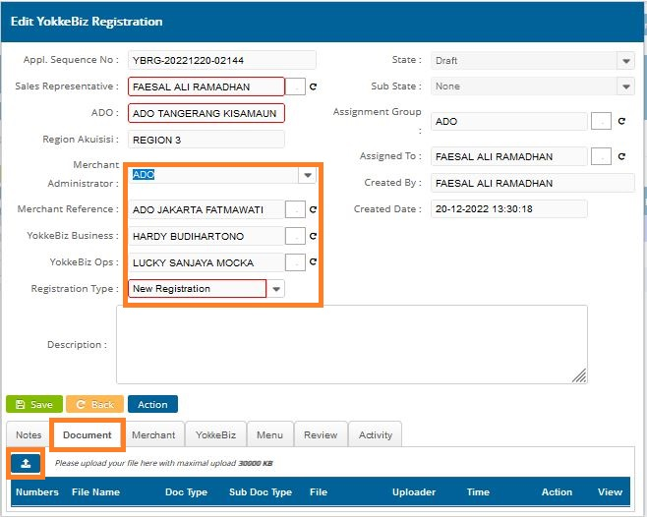
Onboarding Merchant YokkeBiz
Isi Merchant Administrator
Isi Merchant Reference
Isi YokkeBiz Business
Isi YokkeBiz Ops
Isi Registration Type
Pilih menu Document
Pilih tombol upload

Slide 22
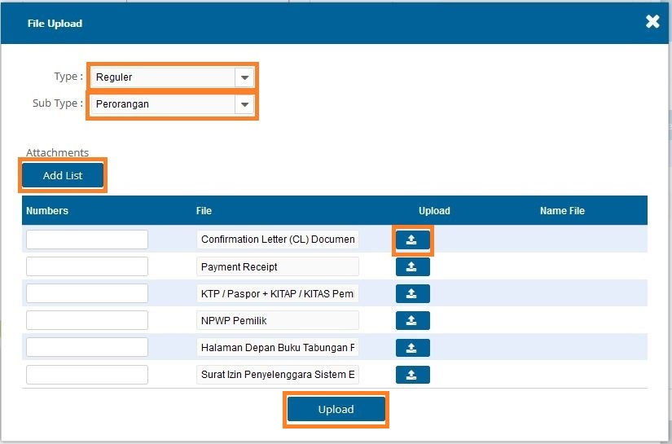
Onboarding Merchant YokkeBiz
Klik Type akan ada pilihan Reguler dan UMKM
Klik Sub Type akan ada pilihan Perorangan dan Badan Usaha
Upload dokmen dengan klik tombol upload
Klik Add dokumen bila ada dokumen tambahan yg akan di upload
Klik Upload

Slide 23
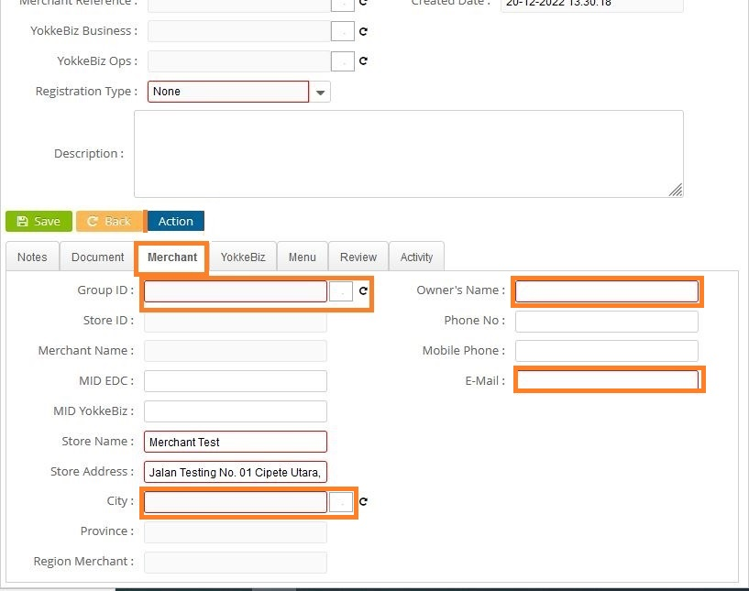
Onboarding Merchant YokkeBiz
Pilih menu Merchant
Klik kolom Group ID
Isi City
Isi Owner’s Name
Isi Email

Slide 24
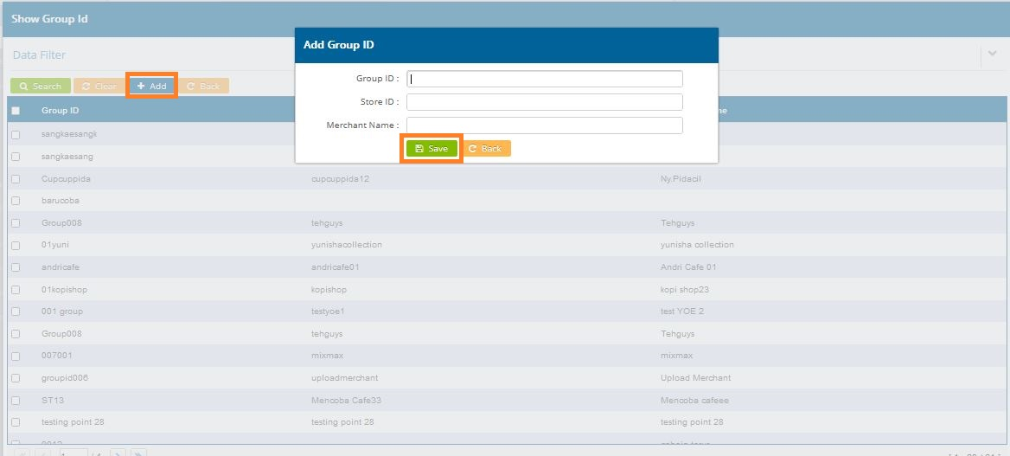
Onboarding Merchant YokkeBiz
Klik Add
Isi Group ID
Isi Store ID
Isi Merchant Name
Klik Save

Slide 25
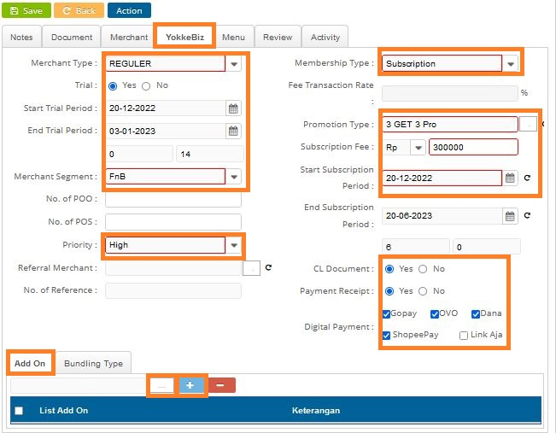
Onboarding Merchant YokkeBiz
Pilih menu YokkeBiz
Isi Merchant Type
Klik Yes bila Trial
Isi Start Trial Priod
Isi Merchant Segment
Isi Priority
Isi Membership Type akan ada pilihan Subcription atau Fee Transaction
Isi Promotion Type
Isi Subscription Fee
Isi Start Subscription Period
Klik Add On bila ada tambahan Add On
Klik Bundling Type bila ada paket Bundling

Slide 26
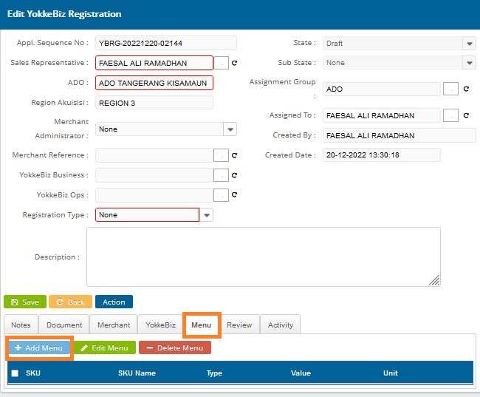
Onboarding Merchant YokkeBiz
Pilih Menu
Klik +Add Menu

Slide 27
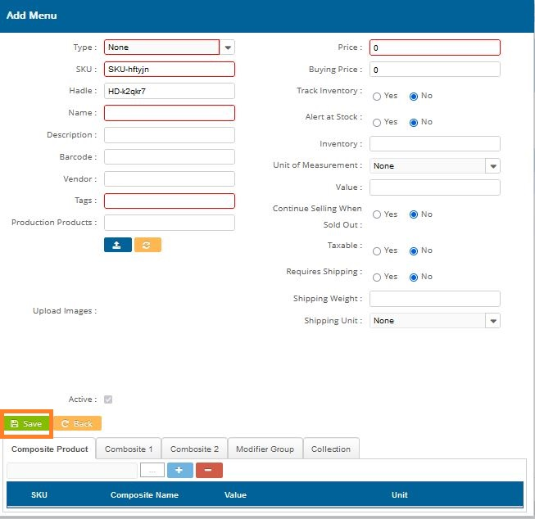
Isi field-field yg tersedia
Klik Save
Bila menu dalam format foto atau dokumen maka bisa di upload pada menu Document

Slide 28
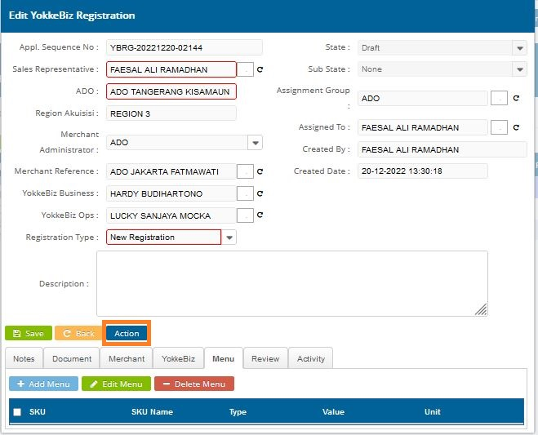
Onboarding Merchant YokkeBiz
Klik Action

Slide 29
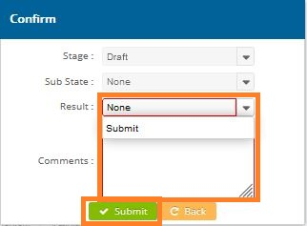
Onboarding Merchant YokkeBiz
Pilih Result dan klik Submit
Isi Comments
Klik Submit
Klik Yes
Tiket Selanjutnya akan masuk ke YokkeBiz Admin (Digital Business) untuk dilakukan pengecekan yg selanjutnya akan dilanjutkan ke team TYB sampai dengan Go Live

Slide 30
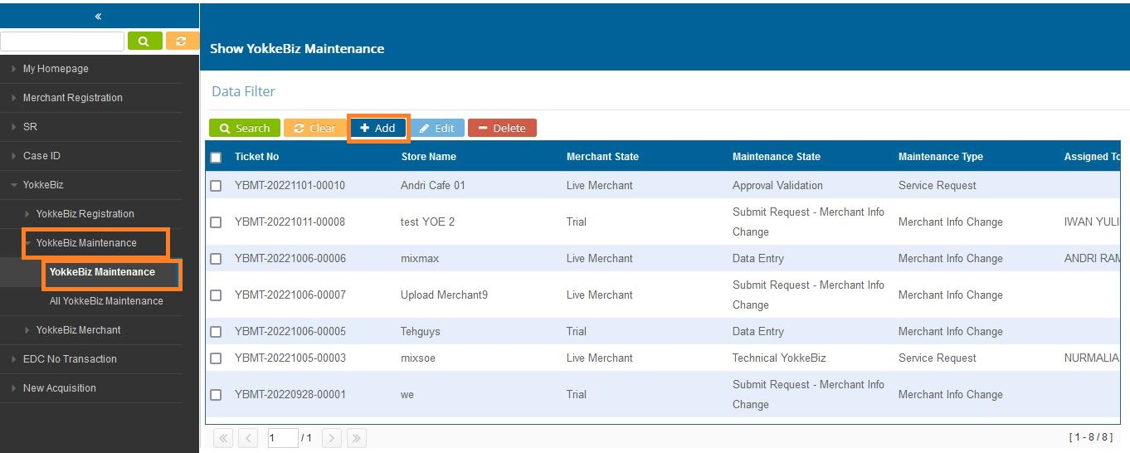
Maintenance Merchant YokkeBiz
Pilih menu YokkeBiz
Pilih YokkeBiz Maintenance
Pilih YokkeBiz Maintenance
Klik Add

Slide 31
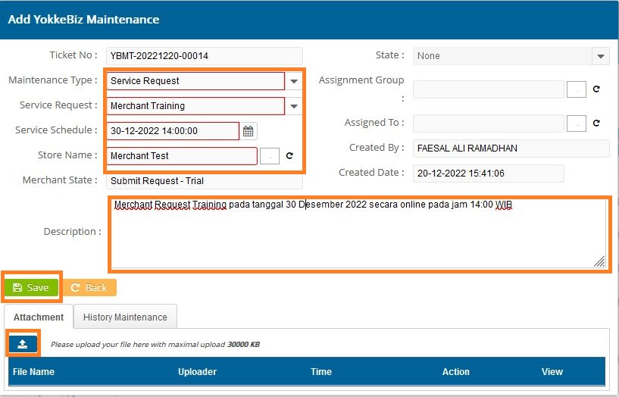
Maintenance Merchant YokkeBiz
Isi Maintenance Type Service Request
Isi Service Request ada pilihan Merchant Training dan Merchant Problem Solving
Isi Service Schedule Tanggal dan Waktu
Pilih Store Name
Lengkapi informasi pada Description missal Request Training Online atau Offline
Klik tombol Upload bila ada document yg ingin di upload
Klik Save dan Pilih Yes
Tiket Selanjutnya akan masuk ke YokkeBiz Admin (Digital Business) untuk dilakukan pengecekan yg selanjutnya akan dilanjutkan ke team TYB sampai dengan Complete

Slide 32
Mekanisme Alur Status Maintenance – Service Request
32
ADO-Admin | YokkeBiz-Admin | YokkeBiz-Ops | YokkeBiz-Ops Approval
Start
Start
Start
Create Ticket
State: Draft
Create Ticket
State: Draft
Create Ticket
State: Draft
Submit
Submit
Submit
Hasil Submit Data
State: Submit Request
Return
Proses
Lanjut
Submit
Cek Tiket Request
State: Technical YokkeBiz
Proses
Lanjut
Submit
Training/Tech. Support Approval
State: Approval Validation
Pembatalan Request
State: Close - Canceled
Return
Bukti
Pekerjaan
Training/Technical Support Selesai
State: Close - Completed
Approve

Slide 33
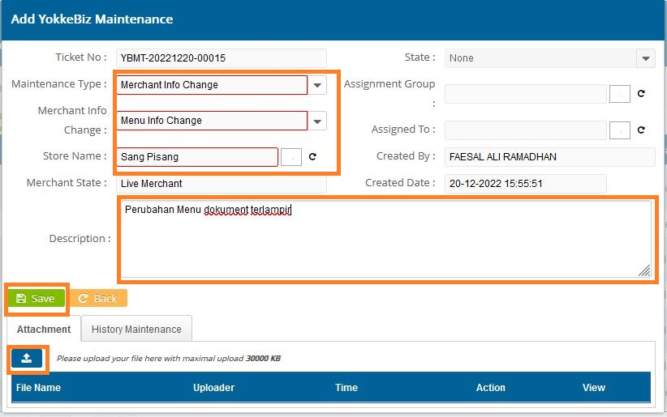
Maintenance Merchant YokkeBiz
Merchant Re-Activation
Extend Trial Priod
Merchant Withdrawal
Renewal Subscription
Merchant Info Change
YokkeBiz Info Change
Menu Info Change
Isi Maintenance Type Merchant Info Change
Isi Merchant Info Change
Pilih Store Name
Klik tombol Upload untuk upload data menu terbaru
Klik Save dan Pilih Yes
Tiket Selanjutnya akan masuk ke YokkeBiz Admin (Digital Business) untuk dilakukan pengecekan yg selanjutnya akan dilanjutkan ke team TYB sampai dengan Complete

Slide 34
Mekanisme Alur Status Maintenance – Merchant Update
34
SR-ADO | ADO-Admin | YokkeBiz-Admin | YokkeBiz-Approval | YokkeBiz-Ops | iSeller
Start
Start
Start
Merchant Re-Activation
Extend Trial Priod
Merchant Withdrawal
Renewal Subscription
Merchant Info Change
YokkeBiz Info Change
Menu Info Change
Create Ticket
State: Draft
Create Ticket
State: Draft
Approval Request
State: Approval Request
Create Ticket
State: Draft
Submit
Submit
Submit
Perlu
Approval
Cat. 1 & 2
Cat. 3 & 4
Approve
Approval
Submit
Hasil Submit Data
State: Submit Request
Return
Permintaan Dokumen
State: Collect Document
Collect Document
Proses
Lanjut
Submit
Cek & Registrasi Data
State: Data Entry
Proses
Lanjut
Submit iSeller
Pembatalan Merchant Update
State: Close - Canceled
Reject
Update Data iSeller
State: Profile Update
Info Change Category:
Extend Masa Trial/Re-Activation
Withdrawal Merchant
Renewal Subscription
Merchant, YokkeBiz, & Menu Info Change
Submit
Merchant Update Selesai
State: Close - Completed

Slide 35
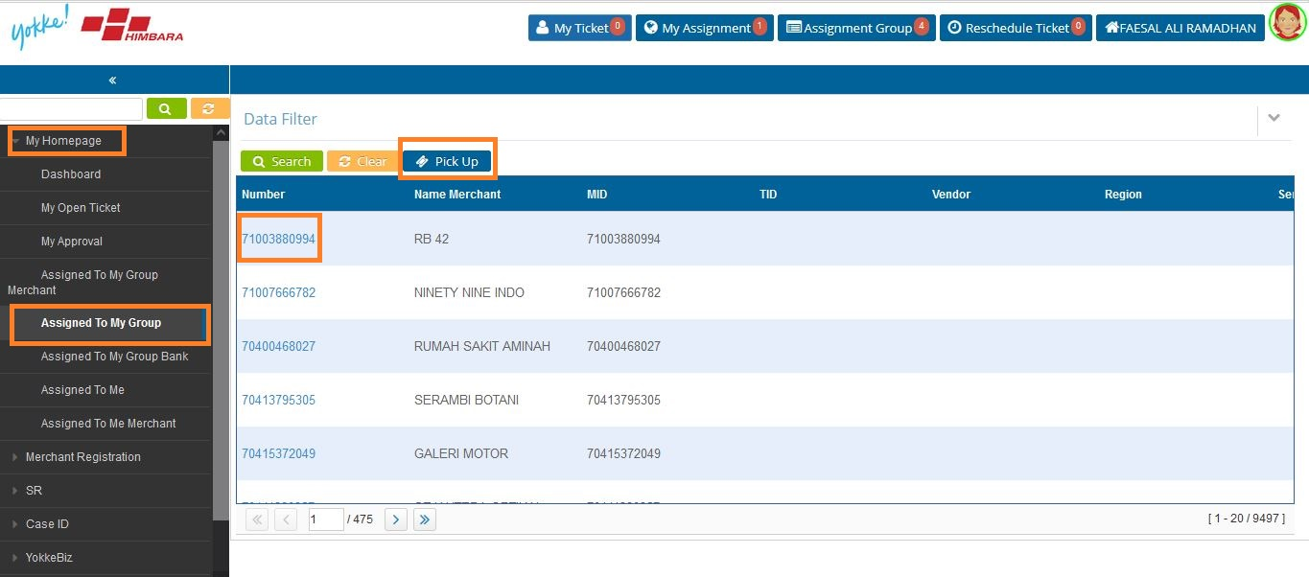
Ticket Return (Collect Document)
Pilih menu My Homepage
Pilih Assigned To My Group
Klik Number Ticket
Klik Pick Up

Slide 36
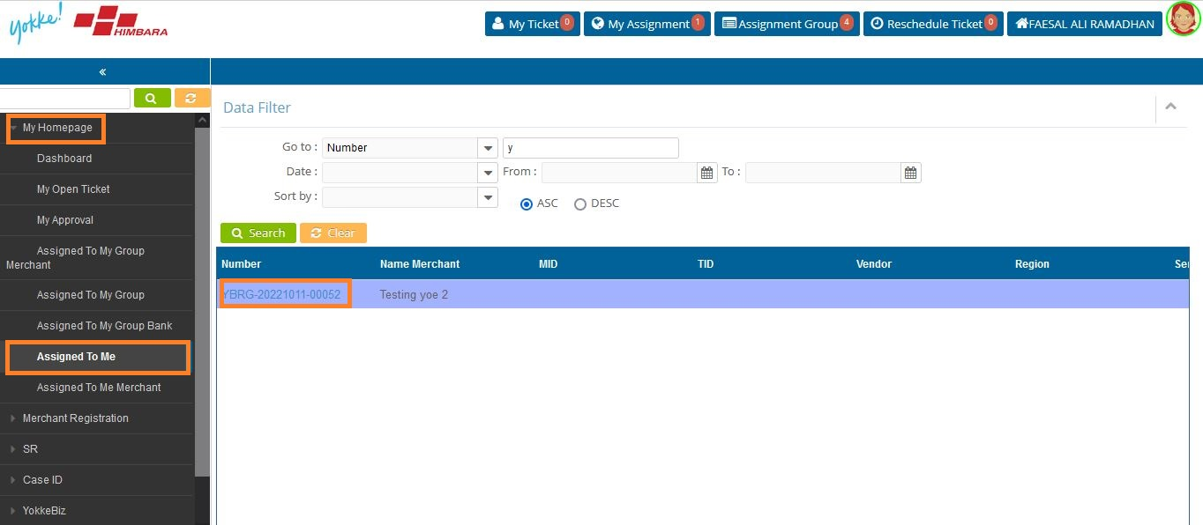
Ticket Return (Collect Document)
Pilih Assigned To My Group
Klik Number Ticket

Slide 37
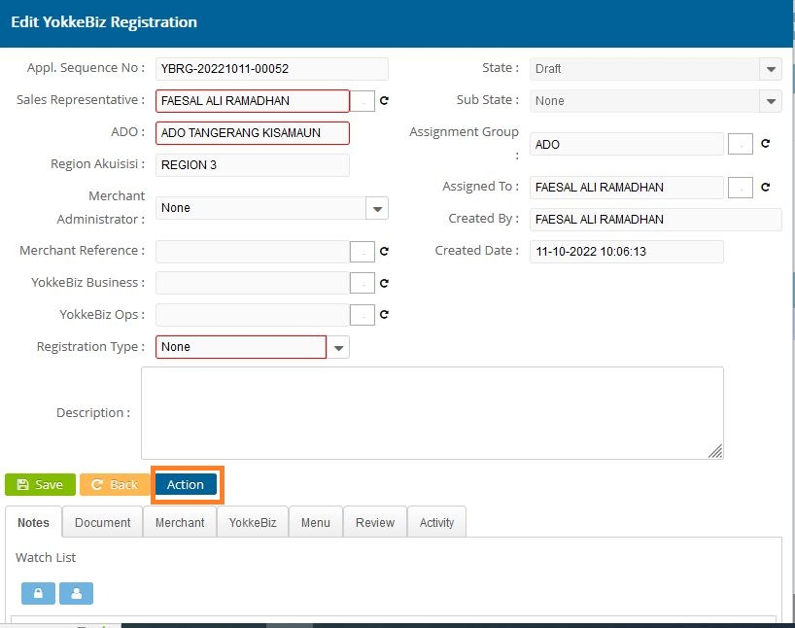
Ticket Return (Collect Document)
Lengkapi Document
Klick Action
Pilih Submit
Isi Comments

Slide 38

Thank You
PT. Mitra Transaksi Indonesia
Copyright © 2021 PT Mitra Transaksi Indonesia. All rights reserved. This document/proposal or any portion is confidential, thereof may not be reproduced or used in any manner whatsoever without the express written permission of PT Mitra Transaksi Indonesia.

